Slide 1
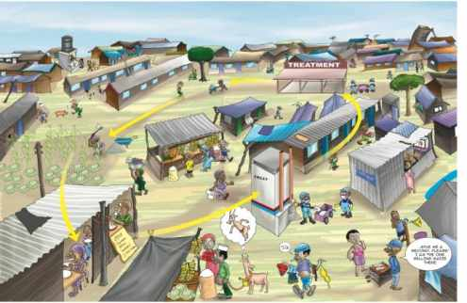
Water Sector Trust Fund
SOCIAL MARKETING
Hand Washing; Knowledge Attitude & Practice (KAP)
people, place, product, price, participation, promotion, policy, programs, positioning, partnerships, poo, pee

Slide 2
Hand washing & KAP (Knowledge, Attitude, Practice)
Knowledge:
Why you need to wash your hands
When you need to wash your hands … after using the toilet, before & after eating, etc.
Where you should wash your hands
What you need to wash your hands … clean water, soap
How you should wash your hands

Slide 3
Hand washing & KAP (Knowledge, Attitude, Practice)
Attitude:
Hand washing is important but:…
there is no need, my hands are clean
I am in a hurry I have no time to wash my hands
its cumbersome
there is no water (not enough water)
there is no soap
I don’t know how to wash my hands properly
etc.

Slide 4
Hand washing & KAP (Knowledge, Attitude, Practice)
Attitude:
Hand washing is not so important because:
there is no reason
it’s a waste of time and money
germs do not kill
its not part of our culture
my hands are usually not dirty
my parents never used to wash their hands and they are okay
the surroundings are so dirty here anyway
the surroundings are very clean here (e.g. the toilet)
no one else does it so why should I?
God decides whether I will become sick or not
etc.

Slide 5
Hand washing & KAP (Knowledge, Attitude, Practice)s
Practice:
Hands are always washed but not properly (due to a lack of knowledge)
Hands are always washed but not properly (due to a lack of water, soap, ashes, etc.)
Hands are not always washed (after using the toilet)
Hands are not washed before or after certain activities (e.g. having a meal)
Hands are (almost) never washed
Hands cannot be washed (due to a lack of water)
etc.

Slide 6
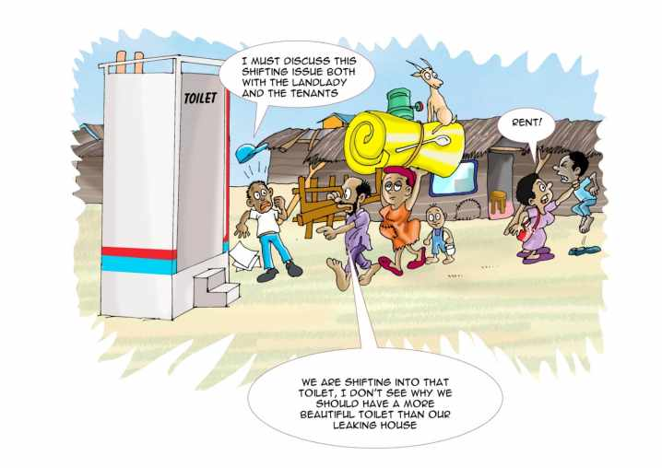
Thank You!

